Slide 1
Find the Hidden Object
In Scratch!

Slide 2
Accessing Scratch
To access scratch, you can either use it on your web browser at dojo.soy/usescratch (you will need to create a free account to save your work) or download it at dojo.soy/downloadscratch.

Slide 3
Add Your project here: https://scratch.mit.edu/studios/27844471/
Or email it to us at clark.us@coderdojo.com

Slide 4
Let’s Get Coding!

Slide 5
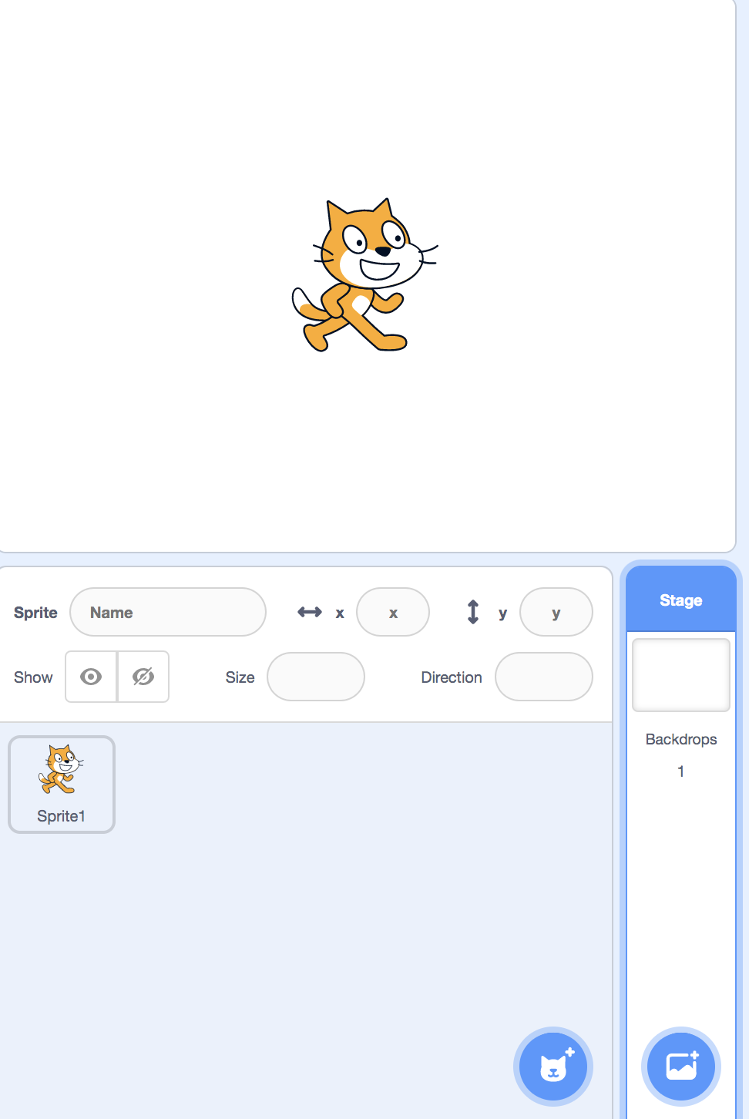

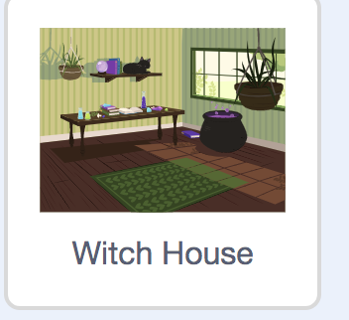
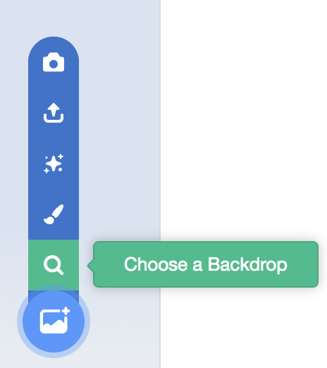
SETTING THE STAGE
2. Select the Backdrops Tab
4. Choose your favorite backdrop
3. Select “Choose a Backdrop”
Select the stage icon on the right

Slide 6
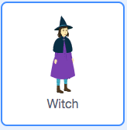
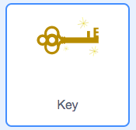

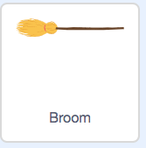
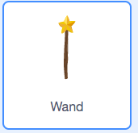
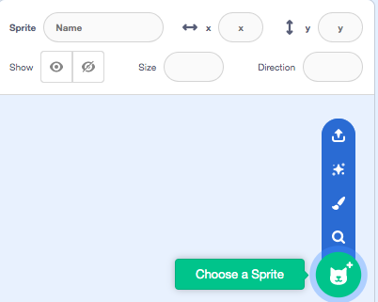

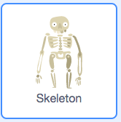
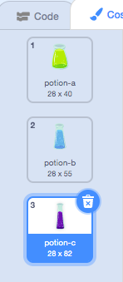

Adding More Sprites!
3. Choose any items you feel would fit into your setting. You can choose as many items as you want! And remember, the more items you have, the more difficult your game will be. Try not to choose items already in the background. These are some of the items I chose:
Press the traschan button on Sprite1 in the Current Sprite Panel.
Tip: Play around with the costumes tab if your item has more than one costume to slightly alter its appearance.
2. Next, hover over the choose a sprite menu in the current sprite panel and select the search icon to choose a premade sprite. You can also draw your own!

Slide 7
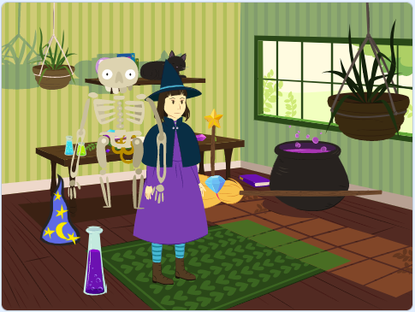
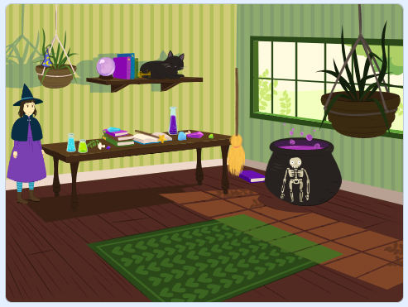
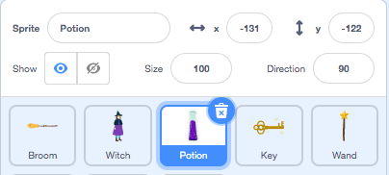
Rearrange and hide your objects!
Before
After
Using your mouse, drag and drop the hidden objects around the stage and make sure they are hidden as best as possible.
Tip: You can edit the size of your objects using the size setting after you have selected a sprite in the panel. Decrease the number to make a sprite smaller, increase the number to make a sprite bigger.
Here, I am editing the size of the potion.

Slide 8
The user will try to find the hidden objects.
When a hidden object is pressed, it will disappear and the user will try to find the rest of the objects.
When the program is reset, all the objects will be seen.
program in words!

Slide 9
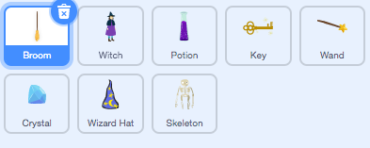

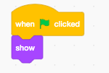
Show each object when the Program is run
1. Select a sprite in the current sprite panel.
2. Drag this block of code from the Events category into the panel.
2. Scroll to the Looks category and drag this block of code to show the object when the program is initially run.

Slide 10
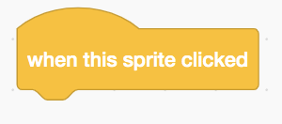
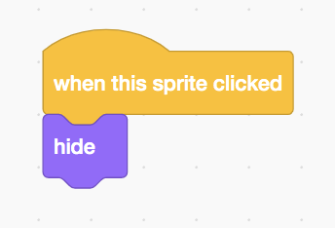
Hide Each Object when it is pressed
1. Select a sprite in the current sprite panel.
2. Drag this block of code from the Events category into the panel.
2. Scroll to the Looks category and drag this block of code to hide the object when the player clicks it.

Slide 11
Repeat the previous two steps for every sprite

Slide 12
But how will our players know which objecTs to look for?

Slide 13
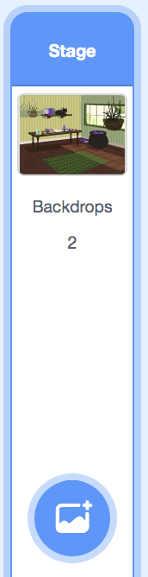
Creating an intro slide
Choose a fairly simple backdrop using the steps we used previously. I uploaded my own Halloween themed background. You can do this by clicking this button instead of the search button.
Now select the backdrops sprite so we can begin coding with them.

Slide 14
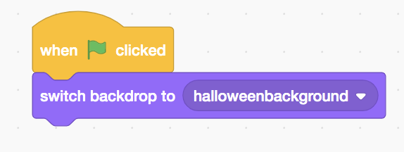
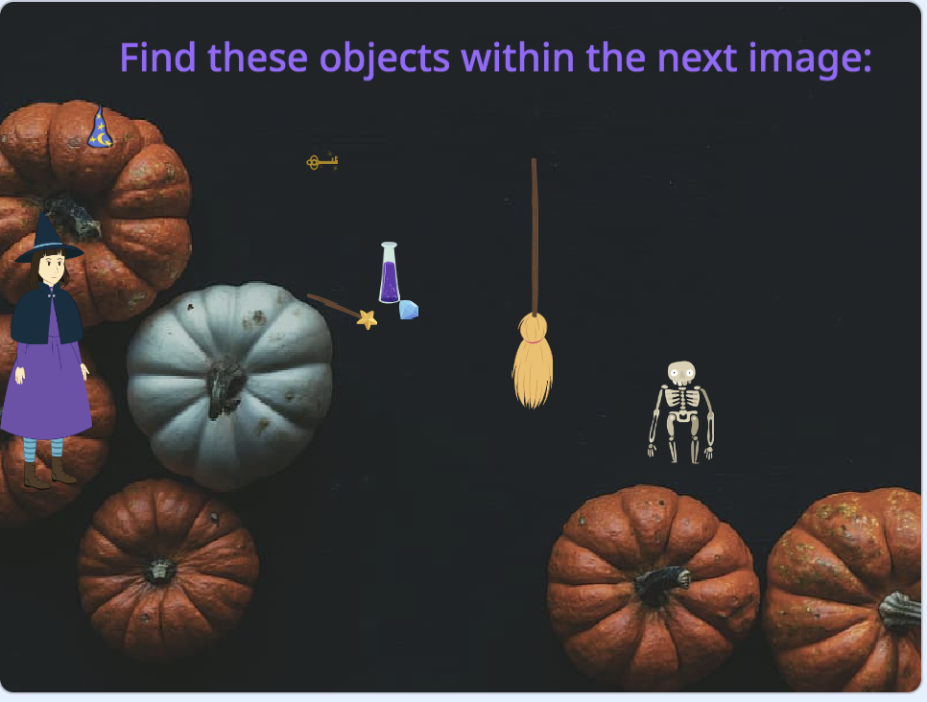
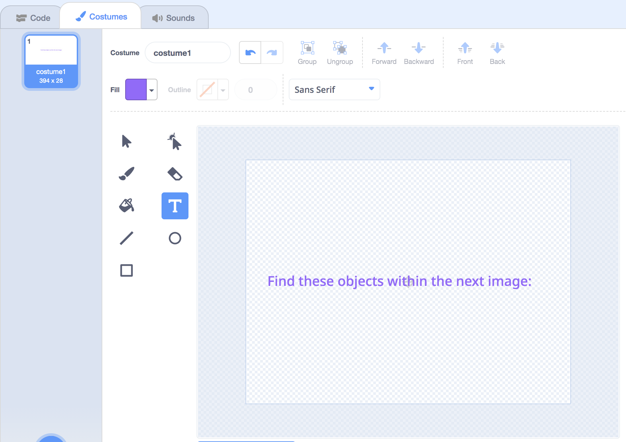
Create an intro slide
Your stage should look something like this after these steps are complete:
1. Drag this block of code from the Events category into the panel.
2. Then, scroll to “Looks” and drag this code out and attach it to the first block. This way, we start off our program with a simple background in which we can explain our program.
3. Create a new sprite using the steps above and go to the costumes tab. Then press the “T” icon and type in the following text. You can edit it however you like and drag it to an appropriate location on the screen.

Slide 15
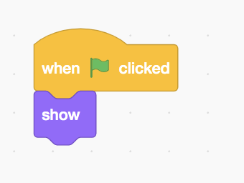
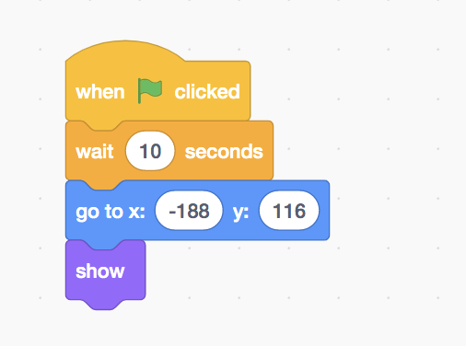
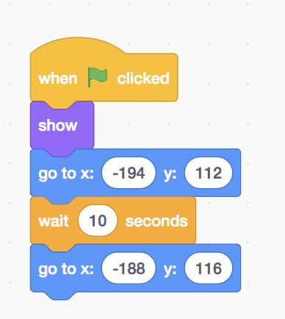
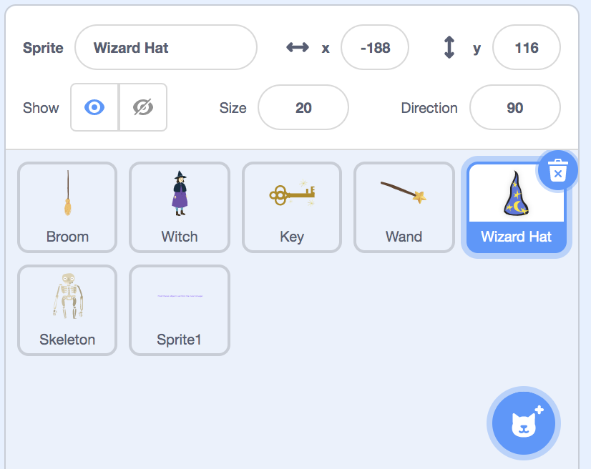
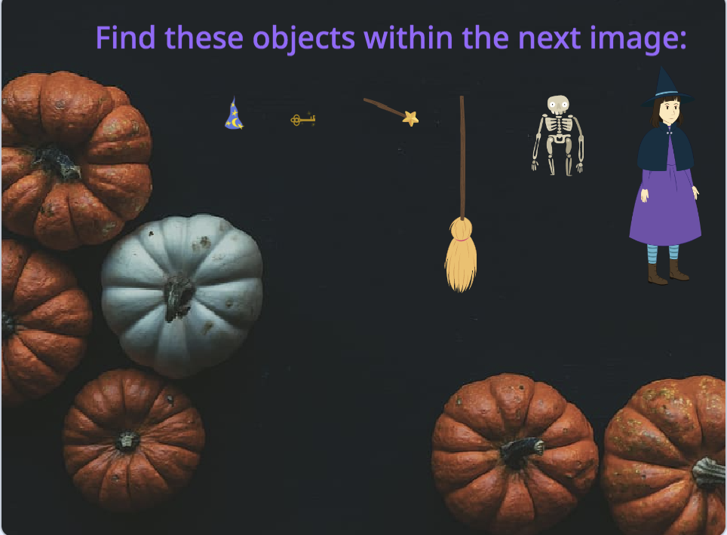
Create an Intro Slide
Before
After
This location can be found in the current sprite panel. This is the location of my object’s hidden spot.
We don’t want all of our hidden objects appearing in their hidden places on the main screen, but after the main screen is seen, we want our objects to appear in their hidden locations. To do this, edit the code for each sprite to appear like this:
On the main screen, however, we want all of our objects to appear in an orderly fashion. To do this, I will drag all my objects to a straight line and keep track of the new location for each using the current sprite panel. Now add in the location from the ordered line so that our object is clearly visible in a menu when the flag is first clicked and only goes to its hidden location after 10 seconds.
Your screen should now look something like this:

Slide 16
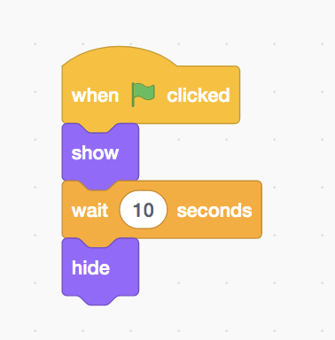
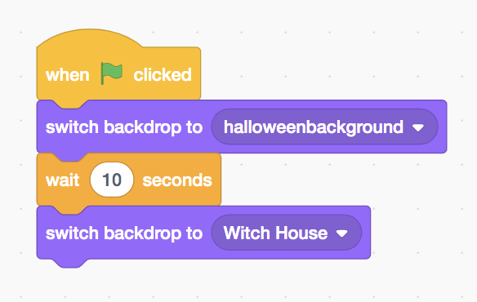
Final EditS
We want the words to disappear when the game starts. Select the words sprite and drag these blocks of code from the Events, Looks, and Control Category to ensure that it disappears in time.
We also want the backdrop to switch after spending 10 seconds on the introduction slide. Select the backdrops icon and edit the code to look like this.
After
Before

Slide 17
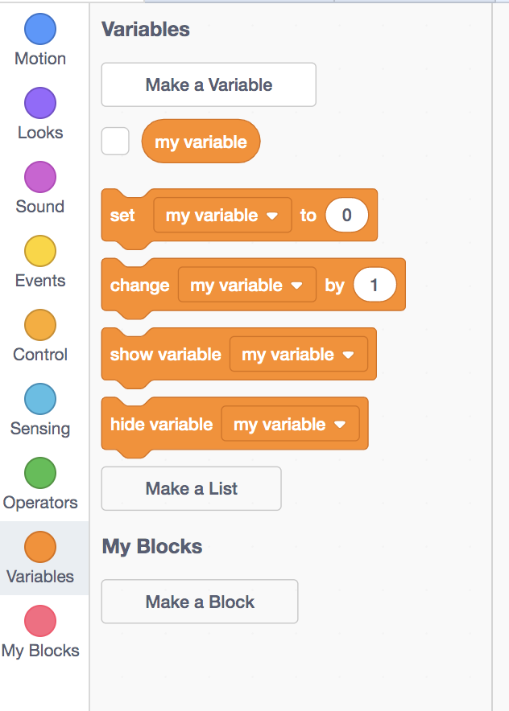
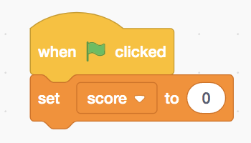
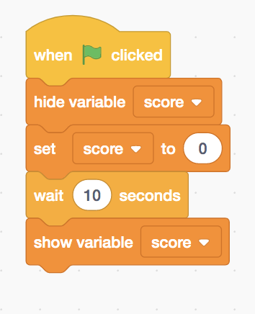
Extension: Keeping Score
We have 6 objects and we want to be able to keep track of the score we get for each object.
To do this, we need to create a variable, which is essentially a container that stores information that can be referenced and used throughout the program.
Select the backdrop sprite. Scroll to the variables category and select make a variable. I named my variable score.
Then, using Events and Variable code blocks, create the following code to set the score equal to zero at the start of the program.
We don’t want the score to show up before the game starts, so we should use use Variable and Control code blocks to edit this code to look like this.

Slide 18
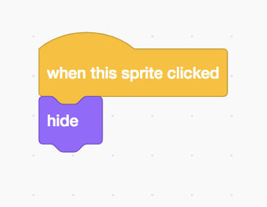
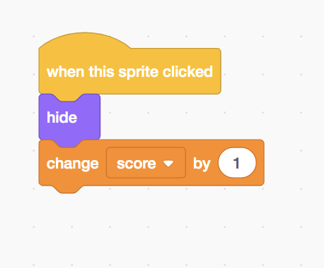
Extension: Keeping Score
For the last step, edit the code in each sprite to look like this. This code will add one to the score every time an object is found.

Slide 19

THANKS
If you have any questions, feel free to email us at clark.us@coderdojo.com.
www.coderdojoclarkedison.com
Coderdojo Clark
@coderdojoclark
Coderdojoclark

